Slide 1
COVID-19: Coronavirus 101

Slide 2
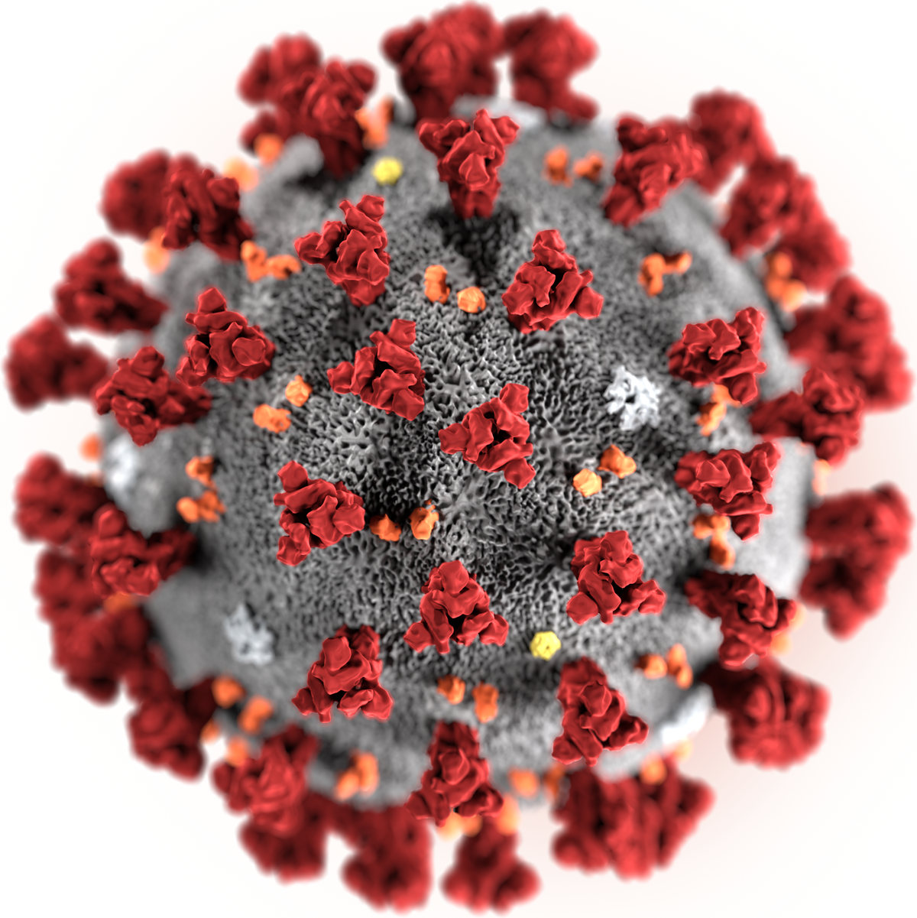
Objectives
1
Understand COVID-19 and its symptoms
2
Understand how the virus spreads
3
Recognize and utilize protective measures
This Photo by Unknown Author is licensed under CC BY-SA

Slide 3
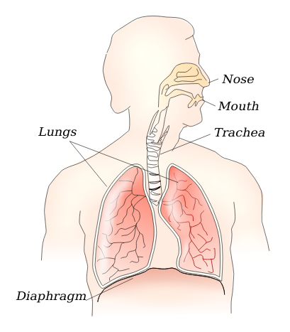
What is it?
COVID-19
The coronavirus is an infectious disease (COVID-19), which is the most recently discovered coronavirus.
General Coronavirus
Coronaviruses are a large family of viruses that can cause illness in humans, or animals. Coronaviruses are known to cause respiratory infections ranging from a common cold, to more severe diseases.
Respiratory infections are infections that interfere with your normal breathing and can affect anything between your sinuses to your lungs

Slide 4



What are the Symptoms?
MOST COMMON
Some people may even experience aches and pains, nasal congestion, runny nose, sore throat, or diarrhea
Fever
Symptoms usually start off as mild/minor and have the potential to increase gradually on intensity of symptoms
Tiredness
If you are experiencing a fever, dry cough, AND having difficulty breathing:
SEEK MEDICAL ATTENTION
(remember to call in advance!)
Dry Cough

Slide 5
COVID-19, Flu, cold, or allergies?
It’s important to understand the different symptoms for COVID-19, the regular flu, a common cold, and allergies; especially because a lot of the symptoms tend to mix with each other
Cold or Allergies
Flu
COVID-19 (coronavirus)
Itchy or watering eyes
Stuffy or runny nose
Sneezing
Fever
Tiredness
Body aches
Cough
Sore throat
Headaches
Runny or stuffy nose
Shortness of breath
Fever
Cough
History of travel, or contact with someone who has travelled
Symptoms appearing 1-14 days after exposure

Slide 6
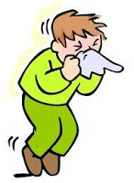
How does it spread?
COVID-19 spreads through droplets of saliva (spit) or discharge from the nose when an infected person coughs or sneezes
When an infected person sneezes or coughs, those droplets land on surfaces and objects that you may come into contact with. When you touch that infected surface, and touch your eyes, nose, and mouth, you may become infected.
It can also be spread by breathing in the droplets of an infected person who coughs or exhales the droplets
***As for a current update, it is not airbourne. The droplets are too heavy to hang in the air and will fall quickly onto floors and surfaces***

Slide 7

Incubation Period
What’s an incubation period?
it’s the time between catching the virus and beginning the symptoms of the disease
the current estimation of the incubation period is 1 to 14 days, most commonly around 5 days
During this stage, it’s especially important to participate in social distancing

Slide 8

Who is the most vulnerable?
As time progresses, it’s been noticed that some populations/type of people are more vulnerable to this virus, and the serious effects it can have on people.
The following people are the most vulnerable:
Older people (aged 50+)
Individuals with underlying medical conditions, such as:
high blood pressure
heart problems
diabetes
chronic respiratory disease
cancer

Slide 9




What if I am experiencing symptoms?
Stay HOME if you are feeling unwell!
If you are experiencing the symptoms:
seek medical attention, BUT, call in advance!
Follow the directions of your local health authority because they have the most up to date information on how to protect you

Slide 10
General Protective Measures
 | What is it? How do I do it? | Why should I do this? How does this help?
Clean Your Hands | Use an alcohol-based hand rub, (like hand sanitizer,) or soap and water to clean your hands | Cleaning your hands with these materials kills the viruses that may be present on your hands
Social Distancing | Keep at least 3 feet (1 meter) distance between yourself and others (especially those who are coughing/sneezing) | When someone near you coughs or sneezes and they’re knowingly (or even unknowingly) carrying the virus, and you’re too close to them, you have the potential to inhale the infected droplets and become infected yourself
Avoid Touching Your Face | Try not to touch your eyes, nose and mouth! | Your hands are always touching surfaces, and those surfaces may have been touched by someone who was infected. When you touch an infected surface, and touch your eyes, nose or mouth, it can give you the virus and make you sick
Respiratory Hygiene | Cover your nose and mouth with your bent elbow or use a tissue when you cough or sneeze | Droplets spread the virus, so by following good respiratory hygiene, you can protect yourself, and those around you from viruses like a common cold, and COVID-19

Slide 11
Other Protective Measures
There are additional protective measures, in addition to the general protective measures, for those: who are in, or have recently visited in the past 14 days, areas where COVID-19 is spreading.
 | What is it? How do I do it? | Why should I do this? How does this help?
Stay at Home if You Feel Unwell | Stay at home even if you feel mild symptoms like a headache or a slight runny nose, until you recover! | Avoiding all contact, especially if you’ve traveled, will protect you and others from the possible spread.
If You Develop Symptoms | If you develop the symptoms of COVID-19, seek medical attention immediately, by calling in advance. Make sure you tell them about your travels or your contact with travelers. | It’s important to let your medical provider know that you’ve traveled and been in contact with those who have traveled, especially to areas where the virus is spreading. There needs to be extra precautions taken.

Slide 12



Things you should NOT do:
Smoking!
Since this virus attacks your respiratory system, smoking may add more strain to your lungs then needed
Wear multiple masks/reusing the disposable masks!
The masks are disposable for a reason! If you need to use one, use it only once and then dispose of it, and use a fresh one the next day
Take Antibiotics
Some people think antibiotics will help their body fight the virus. This is not the case - antibiotics are only used for bacterial infections, not viruses!

Slide 13

Masks - Should I wear them?
Are you ill with COVID-19 symptoms? (especially coughing)
Are you looking after someone who may have COVID-19?
Keep in mind:
disposable face masks can only be used once
there is a world-wide shortage of masks, which needs to be used by medical professionals in the field, and those who are ill, or looking after the ill, so if you do not need the mask, please do not waste it!
If “no” to any of these questions: You should NOT be wearing a mask.

Slide 14




Are there treatments or a cure?
At this point in time, there are no treatments or cures for COVID-19.
BUT you can use traditional or home remedies to alleviate the symptoms that arise from the virus and provide yourself some comfort.
There are currently western and traditional medicines and ongoing clinical trials, in search of a cure, vaccine, and overall better preventative measures for COVID-19.

Slide 15
STAY INFORMED!
Every environment, town, state, province, and country have different methods of preventative measures.
That’s why it is super important to follow the advice and regulations from LOCAL health and government authorities. This includes any restrictions on travel, local movement, business closures, and gatherings.

Slide 16
Thank you

Slide 17
Credits:

